Slide 1
Risk assessment and triage of children in school setting
Eugene Grudnikoff MD
Nov. 2, 2015
egrudnikof@nshs.edu

Slide 2
Objectives
Why evaluate children in schools?
Meaningful evaluation is possible
Familiar setting is the best setting
Evaluation make a difference
How to evaluate a child in school?
Understand events that signify distress
Engage the child
Understand his/her distress
Assess Risk
Implement safe and effective plan (with help)
Notes:
This talk is about evaluating children at schools.
I'll talk about Why do it; why take on that commitment and responsibility.
I’ll make the case that evaluating a child, even for something as scary as suicidal thoughts and behaviors is possible. why it's a good setting to assess a child, and I'll show you data that it makes a big difference. I’ll show you that it’s not only possible but necessary and therefore should be done.
The task seems daunting, but when approached in an organized manner, it becomes logical and meaningful. The goal for this presentation is to propose a road map, that can help educators and school staff to deal with children who act out.

Slide 3
Why evaluate at school?
Why Me?
Meaningful evaluation is possible
Why at school?
Trusting relationship in familiar, safe environment = best evaluation
Why Evaluate at All?
Evaluation makes a difference
Notes:
A 14 year old girl comes to the nurse’s office, and says, my boyfriend broke up with me and called me a whore. All I can think about is killing myself.
The knee-jerk reaction is I’m not a doctor, who am I to guess whether this child is going to go home and kill herself. This is scary stuff.
And you are right! And this is very scary stuff. You are not a doctor, and you should not guess if this child will kill herself.
And no one can.
However, this is what you can do:
Talk to the child. Have a meaningful conversation about her world, her stress, her distress, and her support system. You can ask her about suicide. You can also engage her in a plan to stay safe. You can get help from parents, friends, therapists, and doctors in the community or in the hospital.
Because nothing we are going to talk about requires skills or expertise that you don’t already have. It requires a commitment to a logical approach and willingness to see the problem as a complex rather than overwhelming problem.
Why is the school the best place to evaluate a distressed child? The most meaningful evaluation is done by a familiar person in a familiar environment. Familiar works both ways: a child will be more comforatble, because she is familiar with the counselor or the school nurse. And the school personel is familiar with the child, child strengths, stressors, the family and his support structure. We evaluate children in the Emergency room but it is certainly not a familiar environment. Not for the child and not for the doctors who know nothing about their real life.

Slide 4
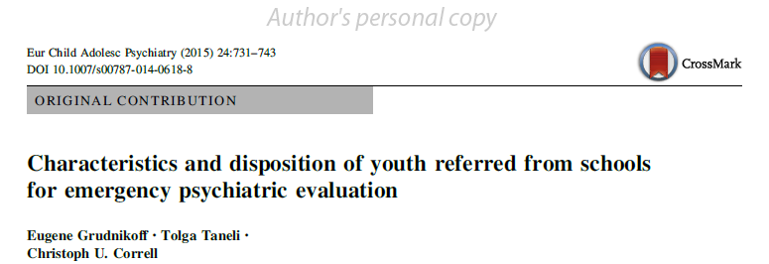
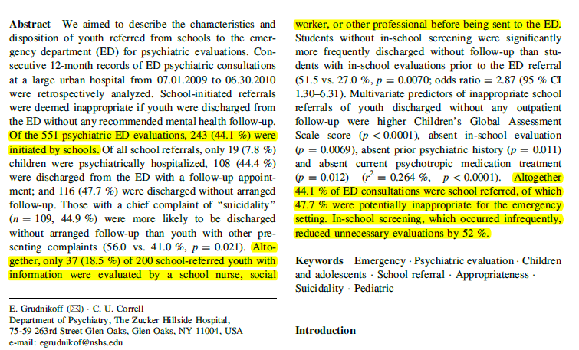
Notes:
This study is titled …
It’s a look at the children referred from school from the vantage point of the emergency room.
In a hospital in Newark NJ, in a 1-year period, there were 551 children evaluated by the psychiatry service; 44%, nearly half either came directly from school, or were brought in at school’s request.
Some schools in NJ had tried to different brief evaluations or screens by a school employee, either a nurse, or school counselor.

Slide 5
In-School Evaluation Matters
Notes:
Inappropriate ER referrals were cut in half.
Most of the children who were referred with a completed School Evaluation, actually needed to be in the emergency room.
We are not asking schools to make a definitive decision about whether the child needs emergency psychiatric evaluation or not. We are encouraging you to have a consistent brief evaluation in stead of a zero-tolerance knee jerk reaction

Slide 6
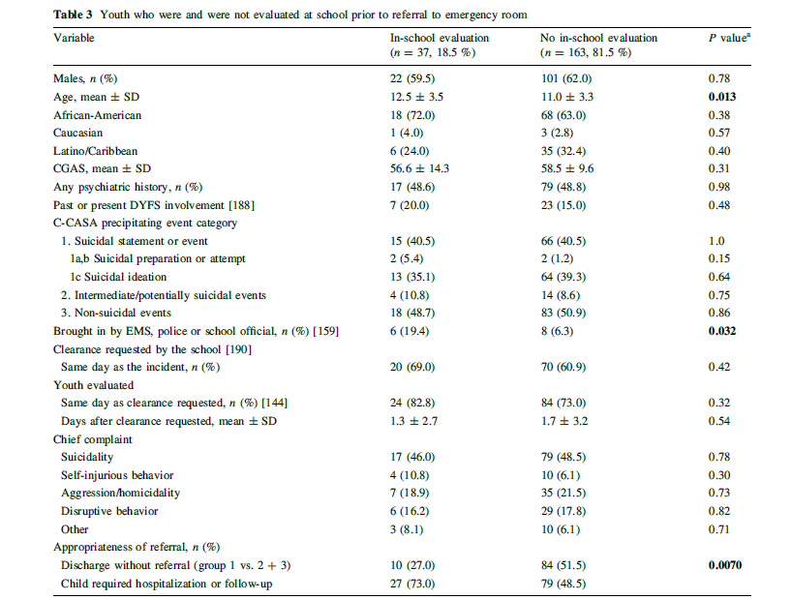

Slide 7
Place of assessment in overall evaluation
Event
Intervention
Assessment
Notes:
The goal of this talk to provide structure and direction to a chaotic and stressful situation – because it strains the school’s resources, and also scary, because it involves the well-being of children.

Slide 8
Place of assessment in overall evaluation
Event
Interventions
Assessment
Suicidal thoughts
Suicidal behaviors
Self-injury
Other disruptions
Notes:
Even comes first, and this a short list that tries to capture all the relevant events that we are discussing.
We will talk about all of these when we are discussing Assement.

Slide 9
Place of assessment in overall evaluation
Event
Interventions
Assessment
Assess behavior
Assess resources
Assess risk
Suicidal thoughts
Suicidal behaviors
Self-injury
Other disruptions
Support and trust

Slide 10
Interventions
Event
Intervention
Assessment
De-escalate
Engage resources
Long-term plan
Safety plan
Notes:
We will spend most

Slide 11
Why Children Act Out
Resources
Stressors/ Risks
School
Bullying
Parents
Academic stress
Child’s Strengths
Anxiety
Notes:
Children act out when their stressors overwhelm their resources, including their own capacity to cope.

Slide 12
Starting an Assessment
Assessment
Support and trust
Assess behavior
Assess resources
Assess risk
Offer support
Establishing rapport and trust
Engage the child
Notes:
I you have seen, children act out at school when they are under tremendous ammount of stress. Early warm support is always helpful.
We are evaluating suicidal thoughts. We are evaluating something that can be scary, or embarrassing, or may lead to being rejected by friends, family, bullied. In some kids. Others will tell about their painful thoughts to anyone who will listen.
The first step in a suicide assessment is establishing rapport and trust. A child is much more likely to share something embarrassing or scary with a person they know to be trustworthy and supportive. The school can identify that person. It may not be the Principal who is in the position to dole out suspensions. A school psychologist or a nurse, who is known to students, is likely to have more trust than an emergency room doctor.
Support, trust, and rapport sound the same. The distinction: Support is something you give; trust is what you get in return. Rapport is the resulting relationship.
Another major reason to engage the child in this process from the very beginning is an important principle called person-centered care. It means involving the child in what is going to happen to him or her. This is very hard.
When we have to use our brain to think fast, to focus, to figure out an intervention, it is tempting to disregard or ignore the noisy distraction that started it all.
The most common feeling that children report in school crisis is a “feeling of being out of control.” An intervention that is done to the individual— rather than with the individual—can reinforce these feelings of helplessness.
One of the principal rationales for person-centered plans is that shared responsibility promotes engagement and better outcomes.
We will talk more about person-centered care when we talk about interventions , about how the child can and should be a major part of the treatment plan. The engagement starts here.

Slide 13
Examples
7-y.o. in cafeteria:
“I’m so hungry, I could die.”
14-y.o. teen comes to school with superficial cuts
“I was feeling alone after fight with boyfriend…”
17-y.o. who tells nurse he took 4 Benadryl
“Mom was yelling at me about grades, and I just wanted to go to sleep and forget about it all ...”
13-y.o. who tells teacher he wants to die
“I often feel that I will kill myself before I’m 18.”

Slide 14
Assessing suicidal thoughts, behaviors, and self- injury
Assessment
Support and trust
Assess behavior
Assess resources
Assess risk
Understand trigger
Isolated vs. ongoing vs. developing event
Understand intent
Suicidal / unsure vs. non-suicidal
Understand suicidal behavior
Impulsive vs. planned
Seek help vs. avoid discovery
Low lethality vs. highly lethal
Notes:
The purpose of assessment is to understand how much distress the child is in.
The main objective is to understand and assess risk. So all our discussion about suicidal thoughts, suicidal behaviors is in service of assessment of risk.
Trigger is what was the last straw.
Intent distinguishes suicidal thoughts and behaviors from non-suicidal thoughts or behaviors.

Slide 15
Assessing suicidal thoughts, behaviors, and self- injury
Assessment
Support and trust
Assess behavior
Assess resources
Assess risk
Understand the trigger
Ongoing situation
Developing event
Isolated event
Lower Risk
Higher Risk
Notes:
The purpose of assessment is to understand how much distress the child
Trigger is what was the last straw.
Triggers can be isolated (for example – this random kid pushed me, I got a bad grade)
Triggers can be ongoing (for example – these two kids always pick on me, our house got flooded in Sandy)
Triggers can be developing or unfolding event (my girlfriend dumped me; I was sexting with this boy, and he told his friends)

Slide 16
Assessing suicidal thoughts, behaviors, and self- injury
Assessment
Support and trust
Assess behavior
Assess resources
Assess risk
Evaluation of intent: severity and persistence
What was the child was thinking about AT the TIME OF the INCIDENT?
What is the child thinking about NOW?
No Suicidal Intent
Ambivalent Intent
Suicidal Intent
Notes:
8 year old in lunch line: I’m so hungry, I could die.
16 yo adolescent who came with multiple superficial cuts
14 yo boy who says he feels hopeless, and feels he will kill himself sooner or later.

Slide 17
Assessing suicidal thoughts, behaviors, and self- injury
Assessment
Support and trust
Assess behavior
Assess resources
Assess risk
Understand Intent: Severity
Suicidal Intent or
Ambivalent about Intent
No intent to end life
Lower Risk
Higher Risk

Slide 18
Assessing suicidal thoughts, behaviors, and self-injury
Assessment
Support and trust
Assess behavior
Assess resources
Assess risk
Understand Intent: Persistence
Resolving suicidality
Persistent suicidality
Lower Risk
Higher Risk

Slide 19
How to ask about suicide
Be direct when asking the “S” question.
BAD
You’re not thinking of hurting yourself, are you?
Better
Are you thinking of harming yourself?
BEST
Sometimes when people have had your experiences / feelings they have thoughts of suicide. Is this something that you’re thinking about?
Did you want to kill yourself when you …?
What stopped you? …
Are there reasons to live?

Slide 20
Assessing suicidal thoughts, behaviors, and self-injury
Assessment
Support and trust
Assess behavior
Assess resources
Assess risk
Understand suicidal behavior
Impulsive
Planned
Lower Risk
Higher Risk
Seeks help
Avoids discovery
Low lethality
High lethality

Slide 21
Assessing resources
Assessment
Support and trust
Assess behavior
Assess resources
Assess risk
Home resources
School resources
Friends
Inner strengths
Close with parent(s)
Recent divorce
Supportive friends
Lower Risk
Higher Risk
Single parent
Reaches out for help
Isolates self
Sees therapist

Slide 22
Acute vs. Chronic Risk Factors
Assessment
Support and trust
Assess behavior
Assess resources
Assess risk
Chronic Risk factors do not change
Prior suicide attempt
Family history of suicide
History of trauma
History of depression
Gender dysphoria
… …
Acute Risk Factors can be changed
Bullying
Depression
Anxiety
Grief/loss
Notes:
What are risk factors? These are signs, predictors, or red flags that you would think about when faced with a child at risk. What are some risk factors of suicide? Prior suicide attempts, family history of suicide, mental illness, bullying, gender dysphoria, anxiety, insomnia, history of trauma .... The list does not end. Lets talk about risk factors for suicide. Risk factors can be chronic - long term issues that you cannot change - let's call them unmodifiable risk factors; others are risk factors

Slide 23
Some suicide warning signs are more serious than others
Suicide note
Making final arrangements
Giving away prized possessions
Talking about death
Reading, writing, and/or art about death 
Hopelessness or helplessness
Social withdrawal and isolation
Lost involvement in interests & activities 
Increased risk-taking
Heavy use of alcohol or drugs

Slide 24
Putting it all Together
Resources
Stressors and Risks
Parents
Bullying
Academic stress
Child’s Strengths
Anxiety

Slide 25
Engaging Resources
Resources
Stressors and Risks
School
Bullying
Parents
Academic stress
Anxiety
Child’s Strengths

Slide 26
Making the decision
Gather the information
How do I remember all the stressors, triggers, risk factors?
Use C-SSRS Check list
Engage resources
Child, family, therapist, etc
No resources → go to ER
Develop safety plan
No safe plan → go to ER
Develop long-term plan

Slide 27
When to go to ER
A suicide attempt
Preparing for suicide attempt
Persistent suicidality with hopelessness (no reasons to live)
Dysfunction with significant risk factors and no accessible resources
Question: When should a child go to the EMERGENCY Room?
When there is an Emergency

Slide 28
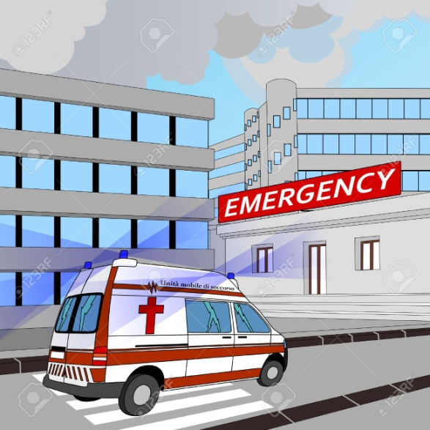
De-escalate
Evaluation and Assessment
Is there an Emergency?
Examples: Suicide attempt; persistent intent; persistent suicidal thoughts with hopelessness; significant self-injury (needs stitches, overdose)
Yes
No Resources
No Safe Plan
Engage resources
Develop Short-term Plan
Develop Long-term Plan

